Slide 1
Profiling Memory and Performance of Large Transformer Models
Ahmed Shokry Soliman
https://www.linkedin.com/in/ahmedssoliman/

Slide 2
Agenda
Problem statement
Proposed Model
Performance Metrics
Introduction
Language Models
Profilers
Motivation
Steps to follow when profiling a transformer model
Our Main Conrtibution

Slide 3
Introduction
Large models have become a key component of many deep learning applications.
These models are typically based on deep neural networks and can require significant computational resources to train and evaluate.
The efficient utilization of these resources is essential for achieving good performance and reducing training time.

Slide 4
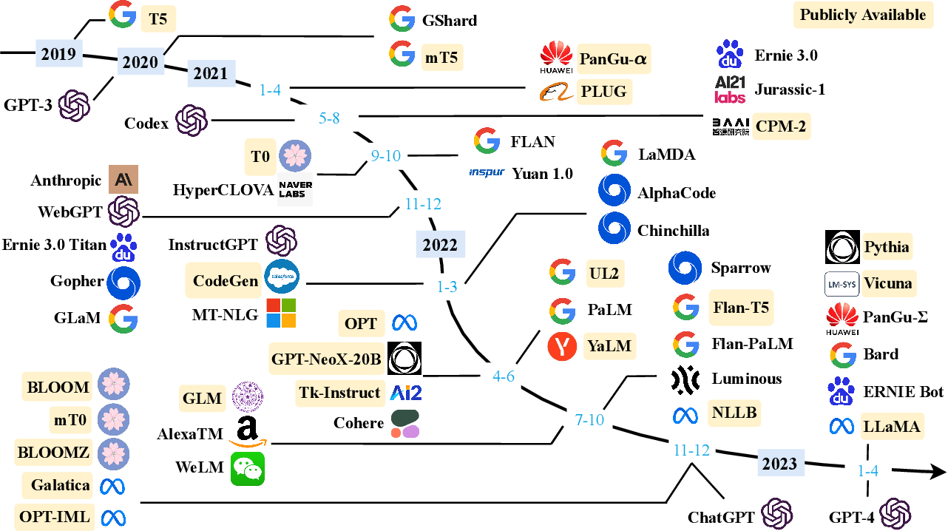
Language Models
Source: Zhao, Wayne Xin et al. “A Survey of Large Language Models.” ArXiv abs/2303.18223 (2023): n. pag.

Slide 5
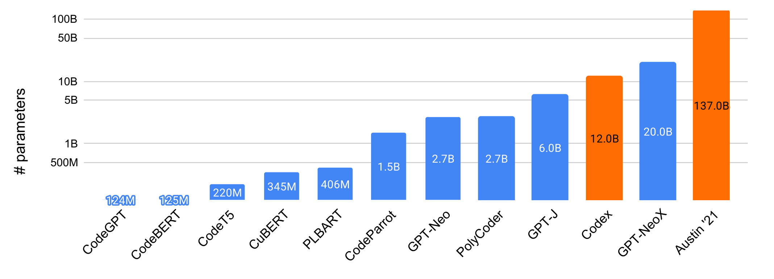
Existing language models of code, their sizes, and availability ( open source vs. not open-source ).
Source: https://arxiv.org/pdf/2202.13169.pdf

Slide 6
Problem Statement
Deep learning models have become increasingly complex, requiring more computational power and longer training times.
In response, researchers and practitioners have developed various tools and techniques to optimize the performance of these models.
Profiling the resource consumption of large language models can be challenging due to:
The complexity of the models
The large number of parameters they contain.

Slide 7
Motivation
Profiling a transformer model involves measuring and analyzing its performance characteristics, such as computational time, memory usage, and throughput.
Profiling a transformer model is an important step in optimizing its performance and ensuring that it can meet the requirements of your application.

Slide 8
Model Types
Model Type | Layer Types | Memory Demand | Compute Demand
Image Classification | Convolutional, Pooling, Fully Connected | Medium to High | High
Object Detection | Convolutional, Pooling, Fully Connected | High | Very High
Semantic Segmentation | Convolutional, Upsampling, Fully Connected | Very High | Very High
Generative Adversarial Networks (GANs) | Convolutional, Upsampling, Fully Connected | High to Very High | High to Very High
Recurrent Neural Networks (RNNs) | Embedding, LSTM, GRU | Medium to High | High
Transformer-based Language Models (LLMs) | Embedding, Multi-Head Attention, Feedforward | Very High | Very High

Slide 9
Profilers
FlameGraph
PyTorch Profiler
Nividia DLProf
PyProf
TensorBoard
TensorFlow Profiler
Profiling JAX program
Cprofile
Pytorch_memlab
GPU Profiler
TorchSpy
PyProf
Scalene profiler
Torchprof
Skyline
Octoml-profile
Microsoft DeepSpeed

Slide 10
Steps to follow when profiling a transformer model
Define the metrics you want to measure:
The model's inference time
The amount of memory used during inference
The number of operations performed by the model
The model's throughput

Slide 11
Steps to follow when profiling a transformer model
Use a profiling tool:
There are many profiling tools available that can help you measure the performance of a transformer model.
NVIDIA's TensorRT, which optimizes and accelerates the inference of deep learning models on NVIDIA GPUs.
PyTorch's autograd profiler, which can help you identify performance bottlenecks in your model.

Slide 12
Steps to follow when profiling a transformer model
Prepare your input data:
To profile your transformer model, you need to provide it with input data that is representative of the data it will encounter during inference.
This can help you get a better understanding of the model's performance under real-world conditions.

Slide 13
Steps to follow when profiling a transformer model
Run the profiling tool:
Once you have prepared your input data and selected a profiling tool, you can run the tool to measure the performance of your transformer model.
The tool will generate a report that summarizes the performance metrics you specified.

Slide 14
Steps to follow when profiling a transformer model
Analyze the results:
After profiling your transformer model, you should analyze the results to identify any performance bottlenecks or areas for improvement.
You may need to experiment with different hyperparameters or architectures to optimize the performance of your model.

Slide 15
Performance estimation
To estimate the memory and compute demands of a given model and determine if it will fit on a given GPU or machine, you can follow these steps:
Determine the size of the model
Determine the batch size
Estimate the memory requirements
Estimate the compute requirements
Estimate the queries per second

Slide 16
Proposed Model
We present a novel approach for profiling transformer models and get the performance optimization of those deep learning models using the combination of the following:
Microsoft DeepSpeed library
ONNXRuntime engine
PyTorch Profiler
TensorBoard for visulalization

Slide 17
Proposed Model
load_model_without_weights
input_shape or input_tensor
Torch profiler
Deep Speed Accelerator and Profiling
Visualization TensorBoard
Show FLOPS, macs and params
Profile each layer in the model

Slide 18
Our Main Contribution
Our approach allows for:
Efficient distributed training, inference
Profiling of deep learning models
Visualization and analysis of performance metrics.
We demonstrate the effectiveness of our approach through many examples from various tasks like image classification and text classification task.

Slide 19
Performance Metrics
FLOPS (Floating Point Operations per Second) is a measure of the computational complexity of a deep learning model. It is the number of floating-point operations that can be executed per second by the hardware on which the model is running.
(1) FLOPS, (2) number of parameters, (3) fps and (4) latency.
These four numbers will help you evaluate the speed of this model. To be specific, FLOPS means floating point operations per second, and fps means frame per second. In terms of comparison, (1) FLOPS, the lower the better, (2) number of parameters, the lower the better, (3) fps, the higher the better, (4) latency, the lower the better.

